Slide 1








































































SRP Project Explorer
Treeview
Plug in
Actions
Command
Fields
Tabs:
Actions
Command
Fields
Validation (see )
Code (see )
i
_

Slide 2
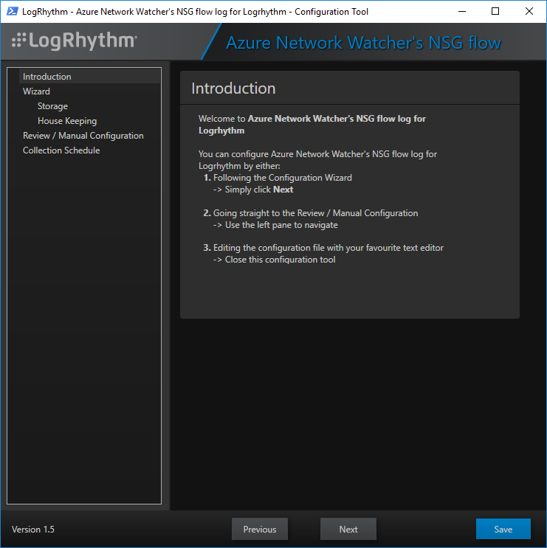



SmartResponse Plug-In Editor
SmartResponse Plug-In Editor
Plug in
Actions
Action XYZ
Action ABC
Output
Preferences
Language
Modules/Extensions
Sign
Build
Test
SmartResponse Plug in
Name:
Project folder:
Author:
Version:
Browse
x
Auto increment
build number
Load from…
Local File:
Cloud Template:
Open
Import XML
Import LPI
Name
Version
Author
LogRhythm Good Practice
1.0 - 2019-
Tony Massé
Python Template
0.5 - 2019-
Dan Crossle
Etc…
Previous
Next
Build

Slide 3



SmartResponse Plug-In Editor
SmartResponse Plug-In Editor
Plug in
Actions
Action XYZ
Action ABC
Output
Preferences
Language
Modules/Extensions
Sign
Build
Test
Actions
Name:
Import from Template:
Order:
P
Create Configuration File
p
q
Names
p
p
q
q
Previous
Next
Build

Slide 4
SmartResponse Plug-In Editor
SmartResponse Plug-In Editor
Plug in
Actions
Action XYZ
Action ABC
Output
Preferences
Language
Modules/Extensions
Sign
Build
Test
Action XYZ
Command:
Parameters:
Field Mapping: Value:
Switch: Validation:
Order:
Note:
%SRP in any Constant Parameter will be replaced by the script name.
Constant
p
q
P
User (Origin)
p
q
P
P
p
q
P
String | Non empty
P
Types
Name
Field / Value
Switch
Valid.
p
p
q
q
Previous
Next
Build

Slide 5
SmartResponse Plug-In Editor
SmartResponse Plug-In Editor
Plug in
Actions
Action XYZ
Action ABC
Output
Preferences
Language
Modules/Extensions
Sign
Build
Test
Output
Output folder:
Folder options:
%SRP_Project%\Output
Browse
One per Version
Single Folder
Previous
Next
Build

Slide 6
SmartResponse Plug-In Editor
SmartResponse Plug-In Editor
Plug in
Actions
Action XYZ
Action ABC
Output
Preferences
Language
Modules/Extensions
Sign
Build
Test
Preferences
License File:
Script File Option:
LogRhythm Plug-In File Option (at Built time):
LogRhythm Code Sample
p
q
Single File
Dual Files
Do Not Generate
Generate LPI File
Previous
Next
Build

Slide 7
SmartResponse Plug-In Editor
SmartResponse Plug-In Editor
Plug in
Actions
Action XYZ
Action ABC
Output
Preferences
Language
Modules/Extensions
Sign
Build
Test
Language
Language Selection:
PowerShell
p
q
Previous
Next
Build

Slide 8
SmartResponse Plug-In Editor
SmartResponse Plug-In Editor
Plug in
Actions
Action XYZ
Action ABC
Output
Preferences
Language
Modules/Extensions
Sign
Build
Test
Modules/Extensions
API wrappers:
Simplifiers / Prebuilt functions:
Names
x
LogRhythm
Azure
AWS
Google
x
ServiceNOW
Etc….
Names
x
SRP Configuration Save
x
SRP Logging
x
SRP Output
Microsoft Windows
x
Microsoft Active Directory
Etc….
Previous
Next
Build

Slide 9

SmartResponse Plug-In Editor
SmartResponse Plug-In Editor
Plug in
Actions
Action XYZ
Action ABC
Output
Preferences
Language
Modules/Extensions
Sign
Build
Test
Sign
Signing Process:
Workflow:
Built-in Signing Process
Certificate Source:
Certificate Path:
Custom / 3rd Party Signing Script/Tool
Command Line:
Note:
%SRP will be replaced by the script name, including full path and
extension.
Built-in
Custom / 3rd Party
Auto: Sign Every Build
Manual: On Demand
Local Certificate Store
PFX File
Cert:\CurrentUser\My
Browse
Browse
Sign
Previous
Next
Build

Slide 10
SmartResponse Plug-In Editor
SmartResponse Plug-In Editor
Plug in
Actions
Action XYZ
Action ABC
Output
Preferences
Language
Modules/Extensions
Sign
Build
Test
Build
Function creation:
Parameters verification/validation:
Pre-build external script:
Post-build external script:
Output:
One Per Action
Single Function
Hard Validation
Warning Only
None
Browse
Browse
Build
Build & Produce LPI Package
Previous
Next
Build

Slide 11
SmartResponse Plug-In Editor
SmartResponse Plug-In Editor
Plug in
Actions
Action XYZ
Action ABC
Output
Preferences
Language
Modules/Extensions
Sign
Build
Test
Test
Run test:
Actions to test:
Test enabled:
Test order:
Parameters:
Built & Test One
Built & Test All
Test One
Test All
p
q
Test
Action
Parameters
p
x
x
p
q
q
p
q
P
P
Name
Value
Previous
Next
Build

Slide 12
Graveyard

Slide 13

SmartResponse Plug-In Editor
SmartResponse Plug-In Editor
Plug in
Actions
Action XYZ
Parameters
Validation
Code
Action ABC
Parameters
Validation
Code
Output
Preferences
Language
Modules/Extensions
Sign
Build
Test
Action XYZ
Name:
Command:
Rename

Slide 14
SmartResponse Plug-In Editor
SmartResponse Plug-In Editor
Plug in
Actions
Action XYZ
Parameters
Validation
Code
Action ABC
Parameters
Validation
Code
Output
Preferences
Language
Modules/Extensions
Sign
Build
Test
Action XYZ
Parameters:
Add/Edit Parameter:
Note:
%SRP in any Constant Parameter will be replaced by the script name.
Types
Values
p
p
q
q
Delete
Constant
p
q
Add

Slide 15
SmartResponse Plug-In Editor
SmartResponse Plug-In Editor
Plug in
Actions
Action XYZ
Command
Fields
Validation
Code
Action ABC
Command
Fields
Validation
Code
Output
Preferences
Language
Modules/Extensions
Sign
Build
Test
Action XYZ
Command:
Constant Parameters:
Add/Edit Constant Parameter:
Note:
%SRP in any Constant Parameter will be replaced by the script name.
p
p
q
q
Delete
Add

Slide 16
SmartResponse Plug-In Editor
SmartResponse Plug-In Editor
Plug in
Actions
Action XYZ
Command
Fields
Validation
Code
Action ABC
Command
Fields
Validation
Code
Output
Preferences
Language
Modules/Extensions
Sign
Build
Test
Action: XYZ

